Slide 1
Dual Active Bridge

Slide 2
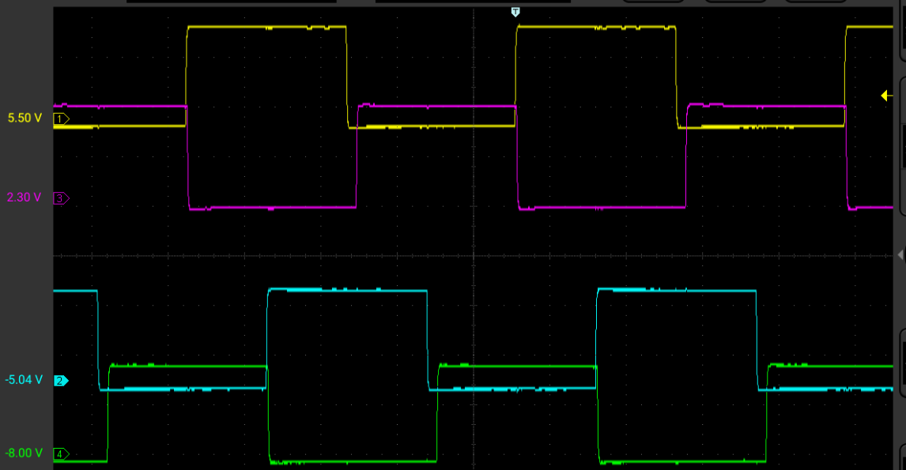
PWM Configuration – Cascaded PWM 1-2-3-4
PRItoSEC Phase 90 – (Bridge Phase / 2)
PWM1
PWM3
Bridge Phase 180 – 360 degrees
PWM2
PWM4

Slide 3
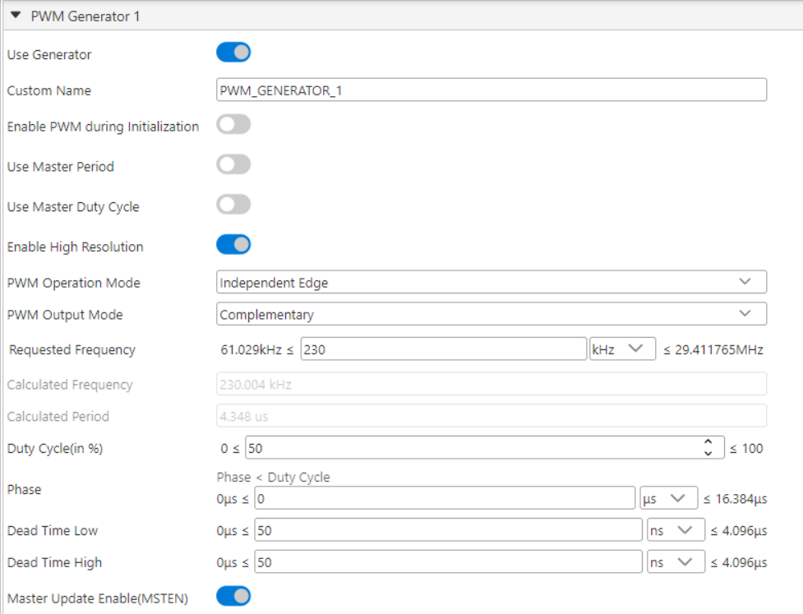
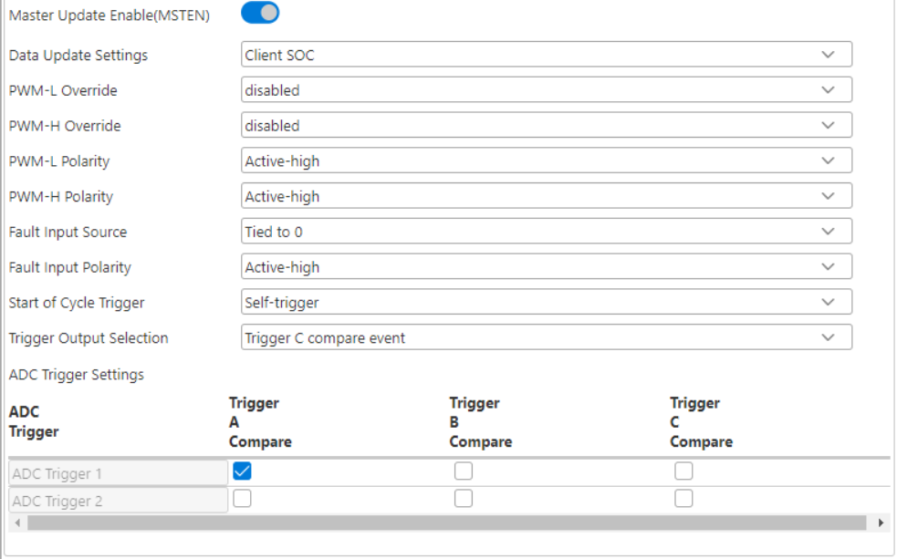
MCC PWM1

Slide 4
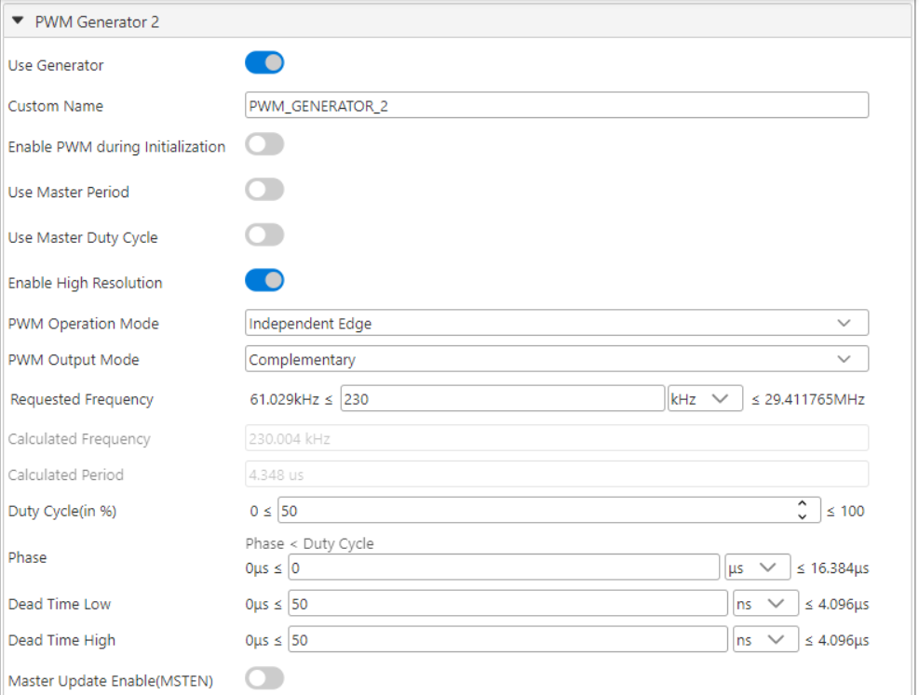
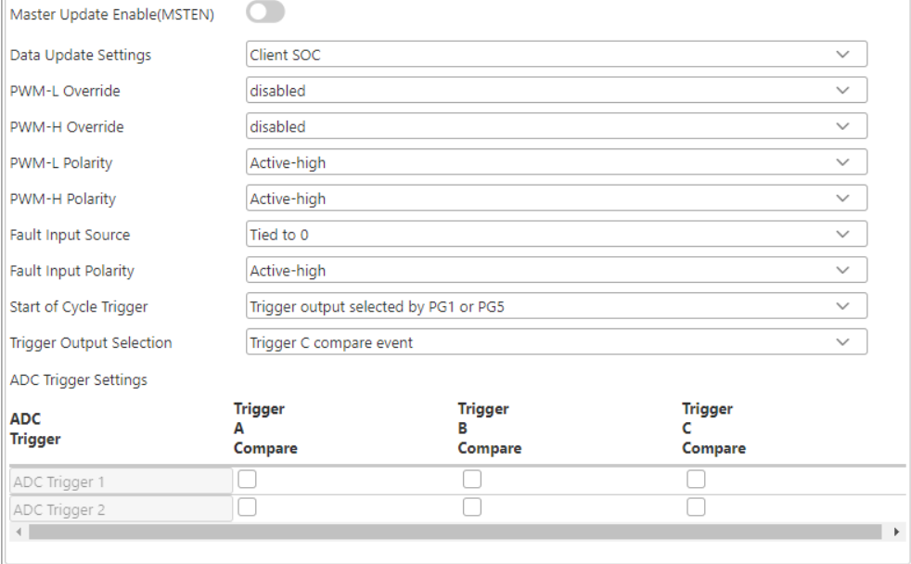
MCC PWM2

Slide 5
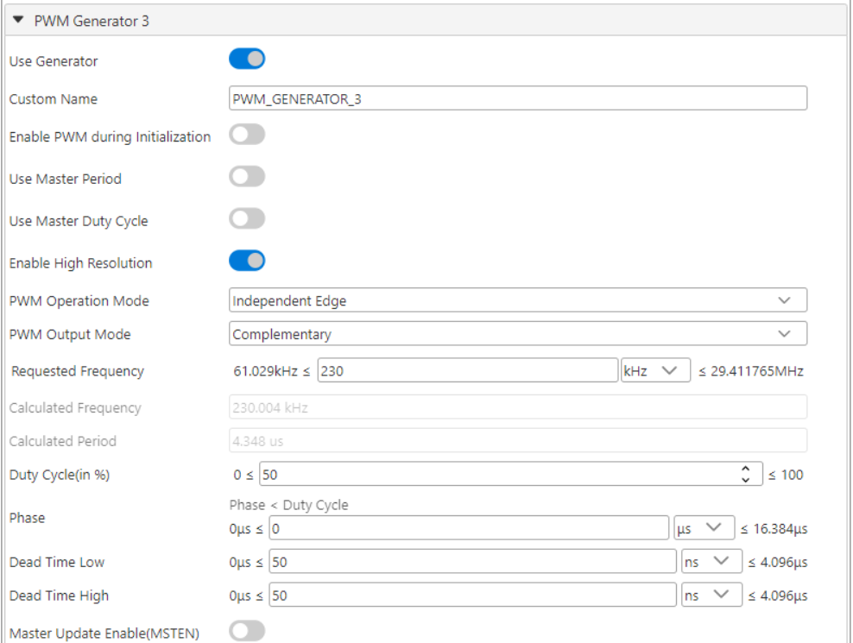

MCC PWM3

Slide 6
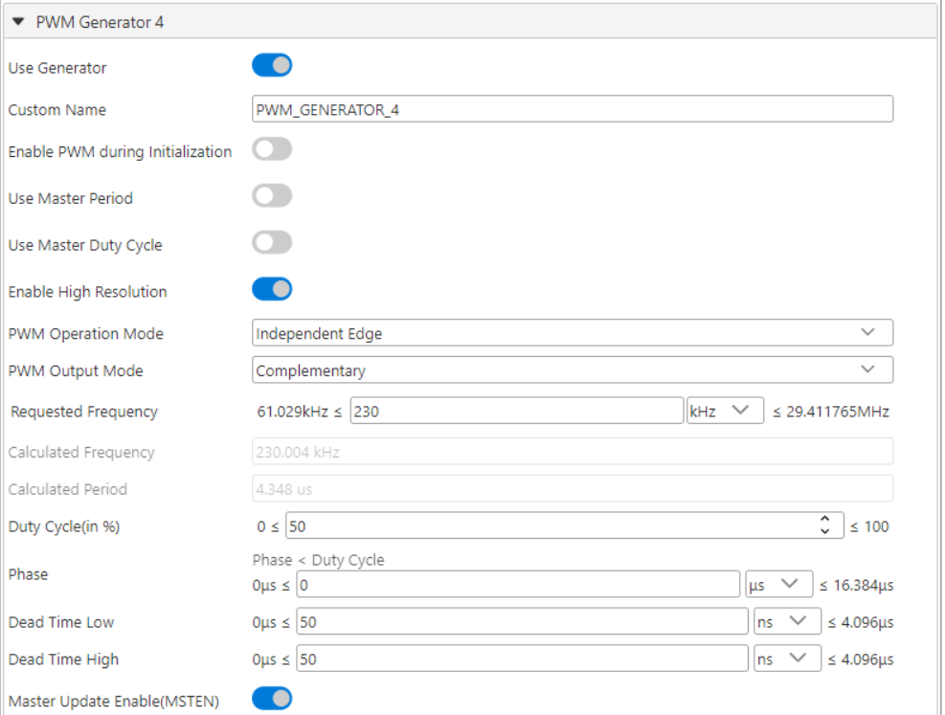
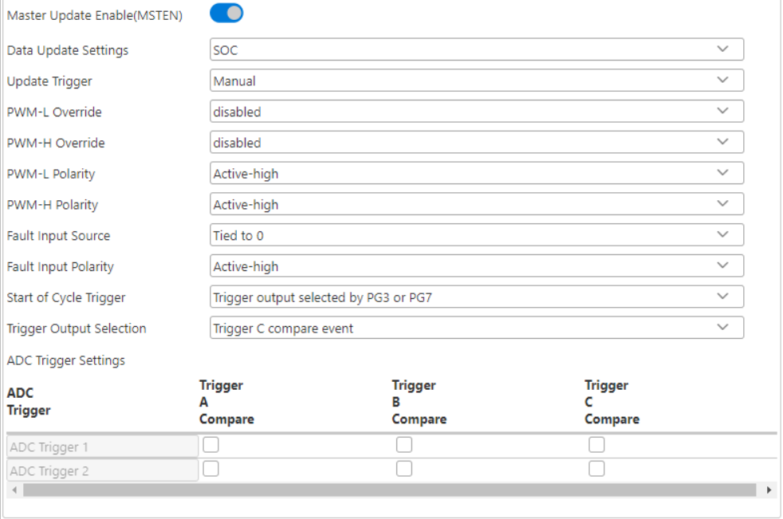
MCC PWM4

Slide 7
FB_Vdd-PWM_P fault implementation
SCCP2 input capture
CLC2
DMA2

Slide 8
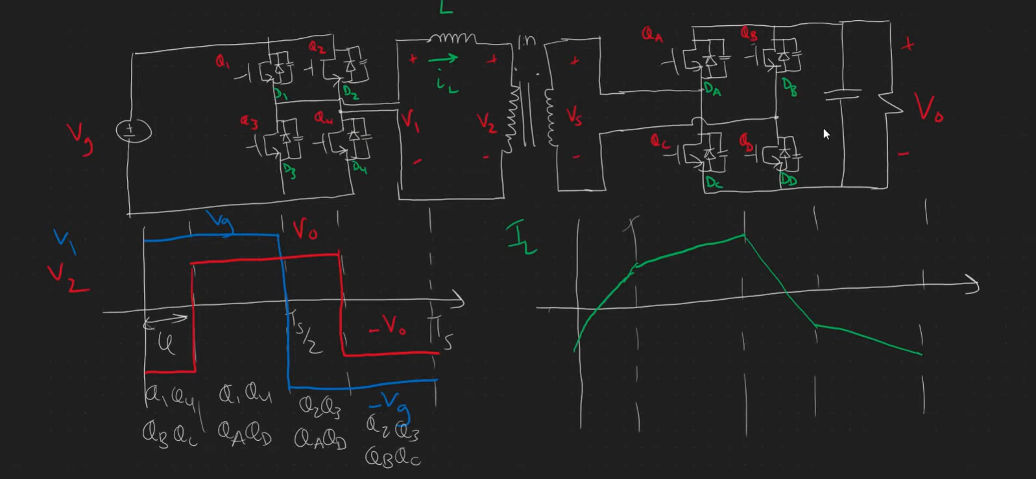
DAB operation

Slide 9
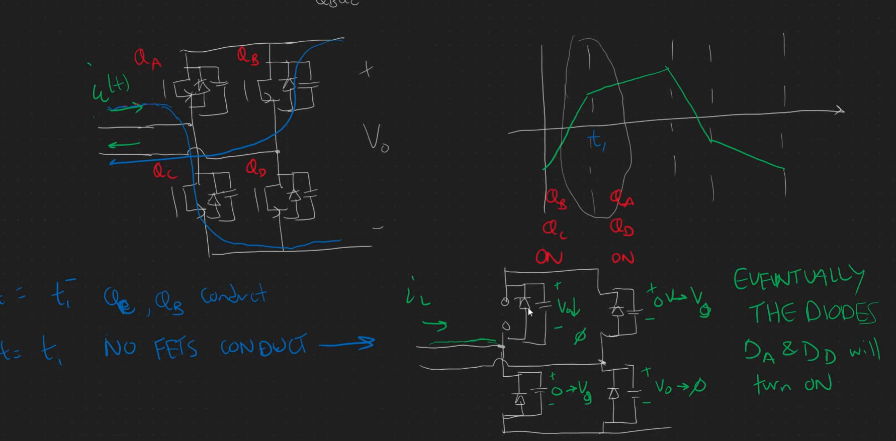
Inductor current naturally forces commutation of Diode

Slide 10
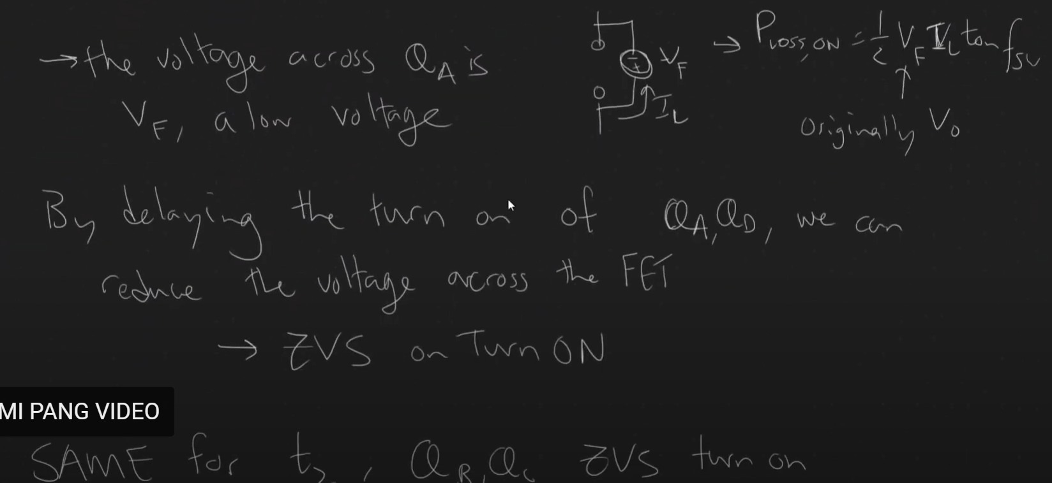

Slide 11
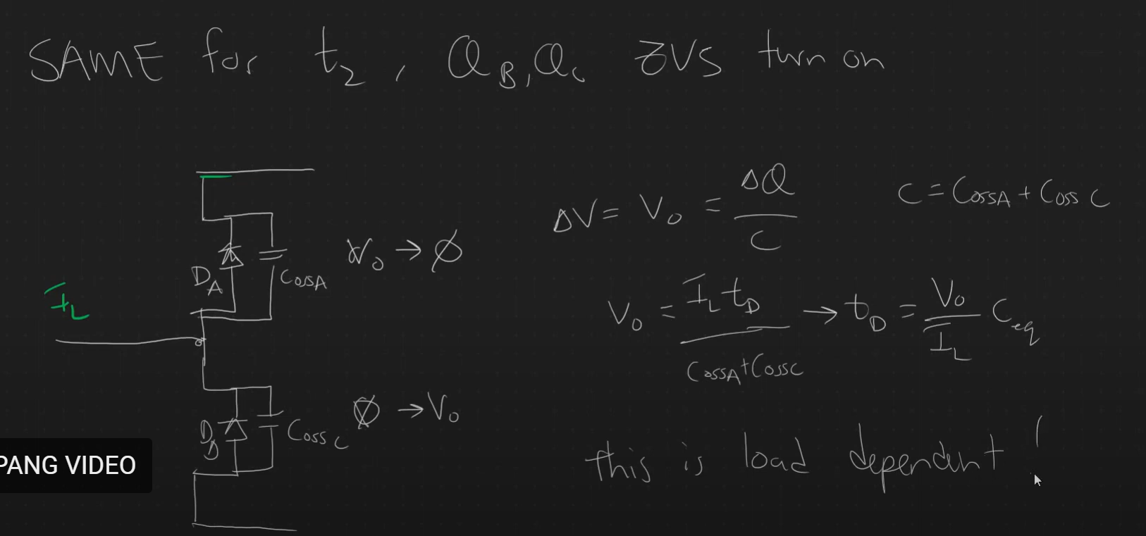
Deadtime equation for ZVS

Slide 12
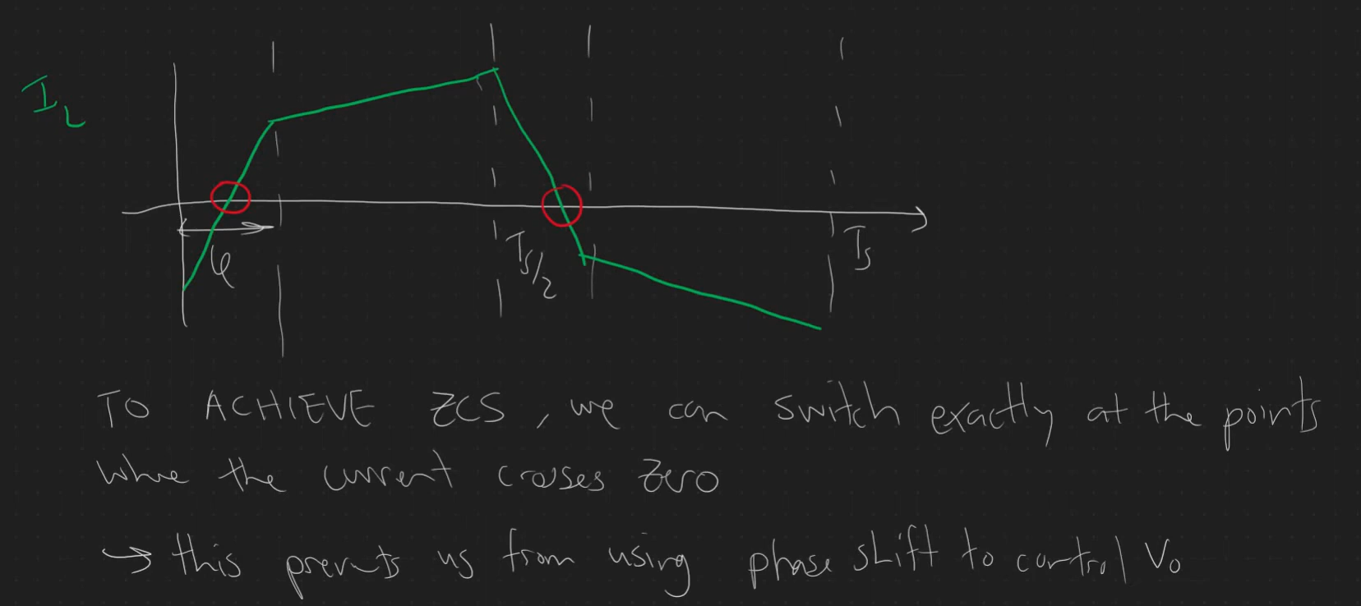
ZCS

Slide 13
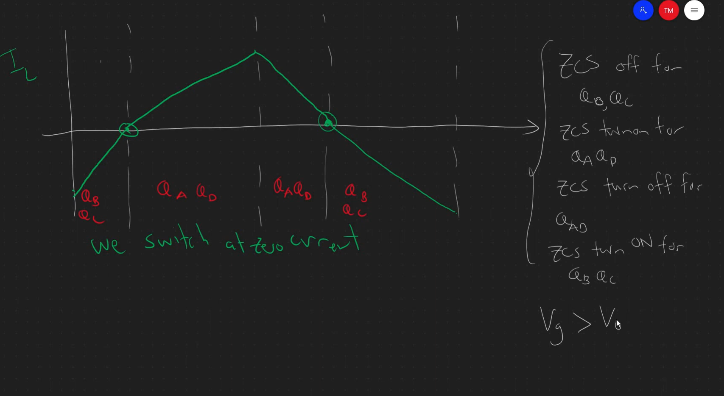
A new modulation to achieve soft switching ZCS

Slide 14
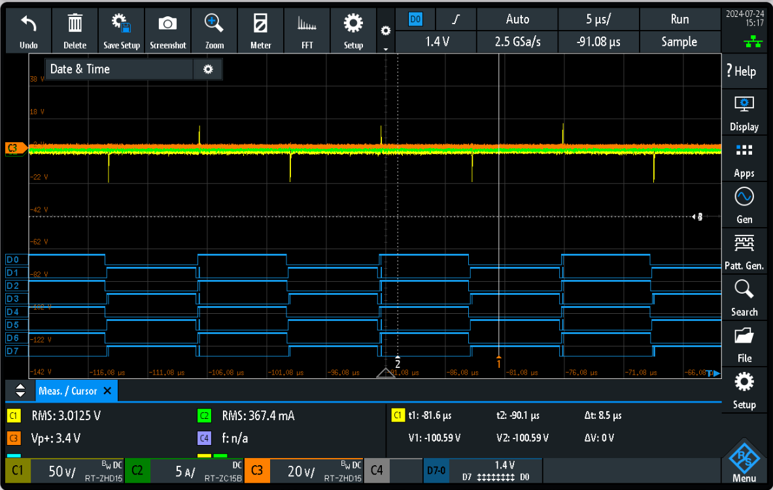
Actual testing to the DAB board in Garching (Open Loop measurement) – no Power flow
Control Phase: 0 degrees
Primary side PWM
PWM1: D0 D1
PWM3: D2 D3
Secondary side PWM
PWM2: D4 D5
PWM4: D6 D7

Slide 15
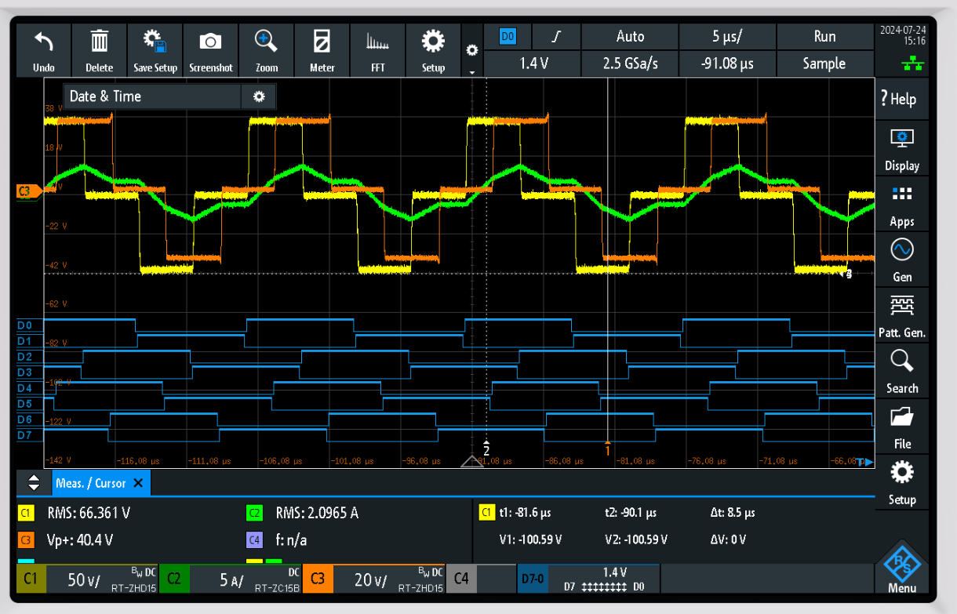
Actual testing to the DAB board in Garching (Open Loop measurement) – with Power flow
Control Phase: 90 degrees
Primary side PWM
PWM1: D0 D1
PWM3: D2 D3
Secondary side PWM
PWM2: D4 D5
PWM4: D6 D7
C1 – yellow (primary Bridge voltage)
C2 - green (transformer current)
C3 - orange (secondary Bridge voltage)

Slide 16
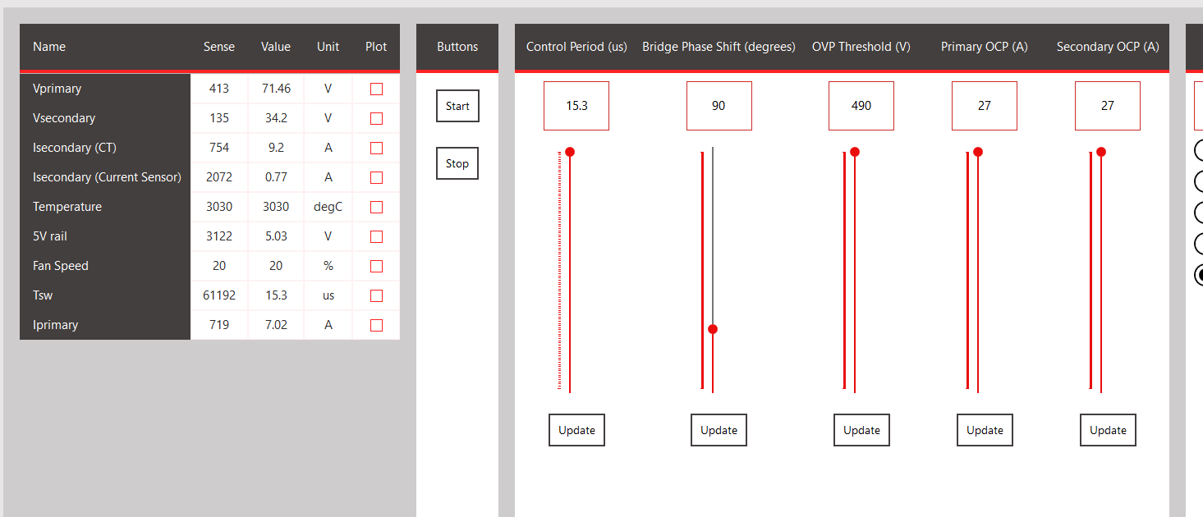
Actual testing to the DAB board in Garching (Open Loop measurement) – with Power flow

Slide 17
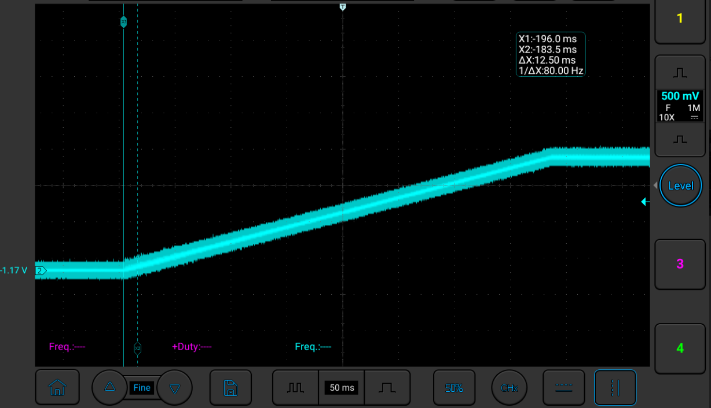
New ramp up –Vloop reference test

Slide 18
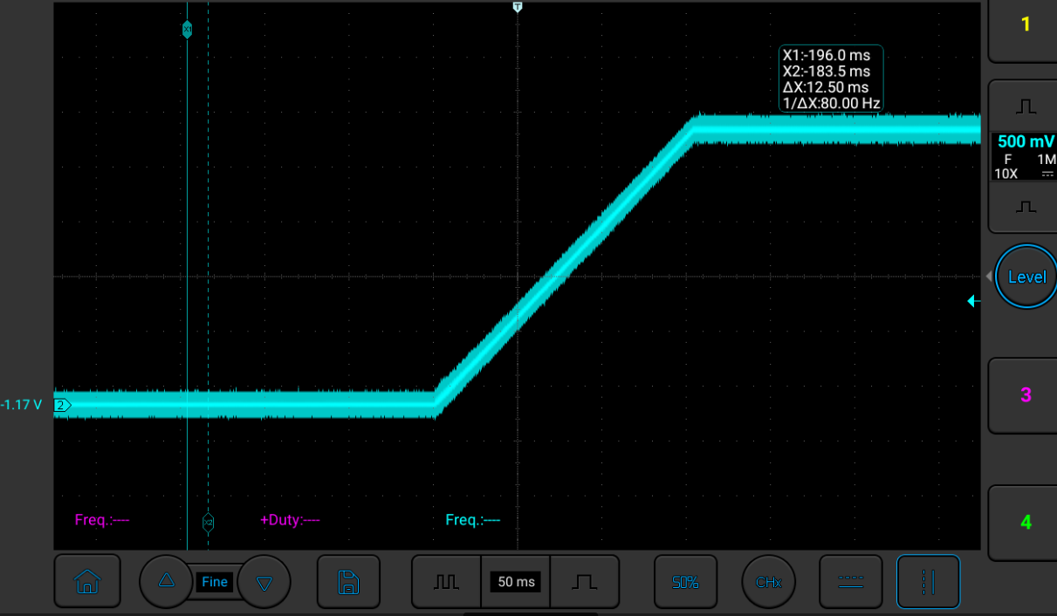
New ramp up –Iloop reference test

Slide 19
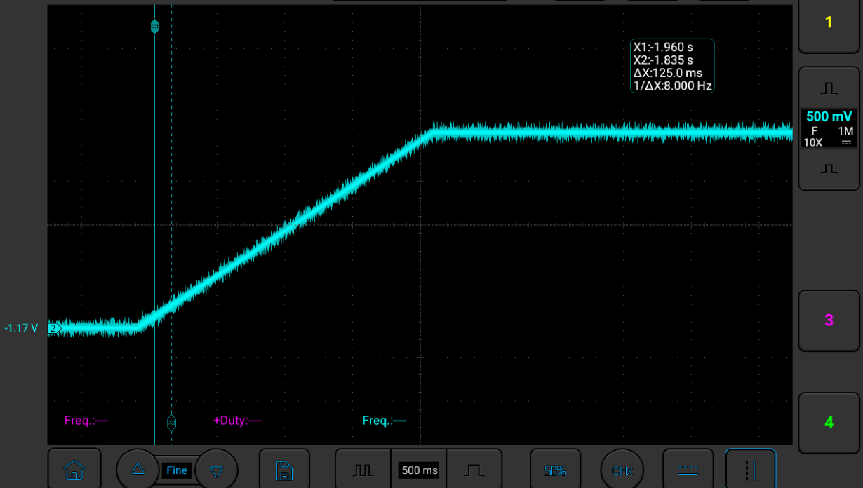
New ramp up –Ploop reference test

Slide 20
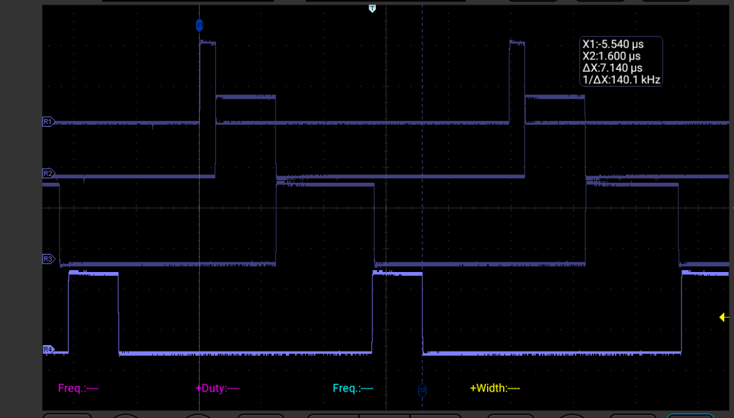
ISR timing tasks :: 100KHz execution time
ADC capture – 504.2 ns
Fault execute – 1.925 us
Control Loop IVP– 3.1 us
PWM distribution– 1.612 us

Slide 21
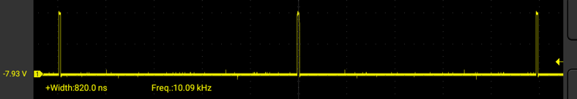
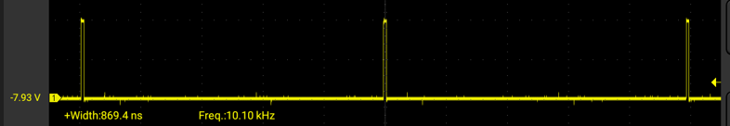
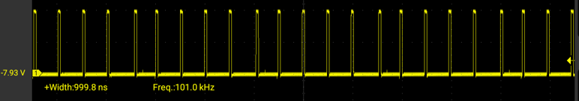
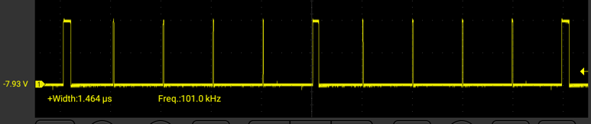
Control loop execution
Vloop
Ploop
Iloop
With averaging code
Interleaved execution
of Vloop and PLoop
Interleave switchover (127ns)

